Slide 1
Education for Sustainable Development in Pathways Colleges: Why and How?
Ways of Practicing

Slide 2
What is Education for Sustainable Development? (ESD)
ESD empowers learners with knowledge, skills, values and attitudes to take informed decisions and make responsible actions for environmental integrity, economic viability and a just society empowering people of all genders, for present and future generations, while respecting cultural diversity.
UNESCO (2020:8)

Slide 3
Why ESD?

Slide 4
The cumulative scientific evidence is unequivocal: Climate change is a threat to human well-being and planetary health. Any further delay in concerted anticipatory global action on adaptation and mitigation will miss a brief and rapidly closing window of opportunity to secure a liveable and sustainable future for all (IPCC, 2022, p.30)

Slide 5
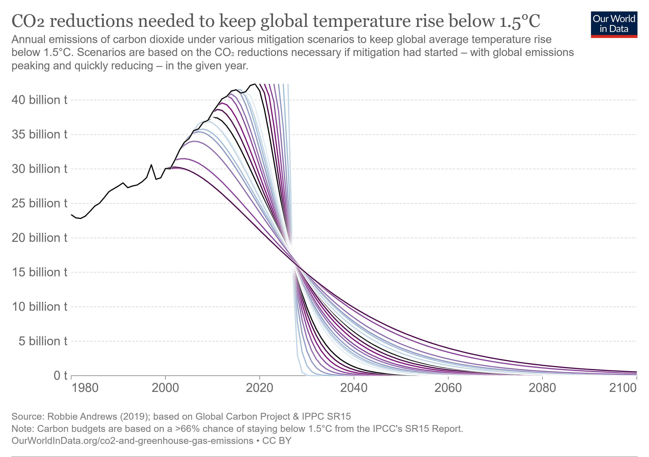

Slide 6
Why ESD in Pathways College?

Slide 7
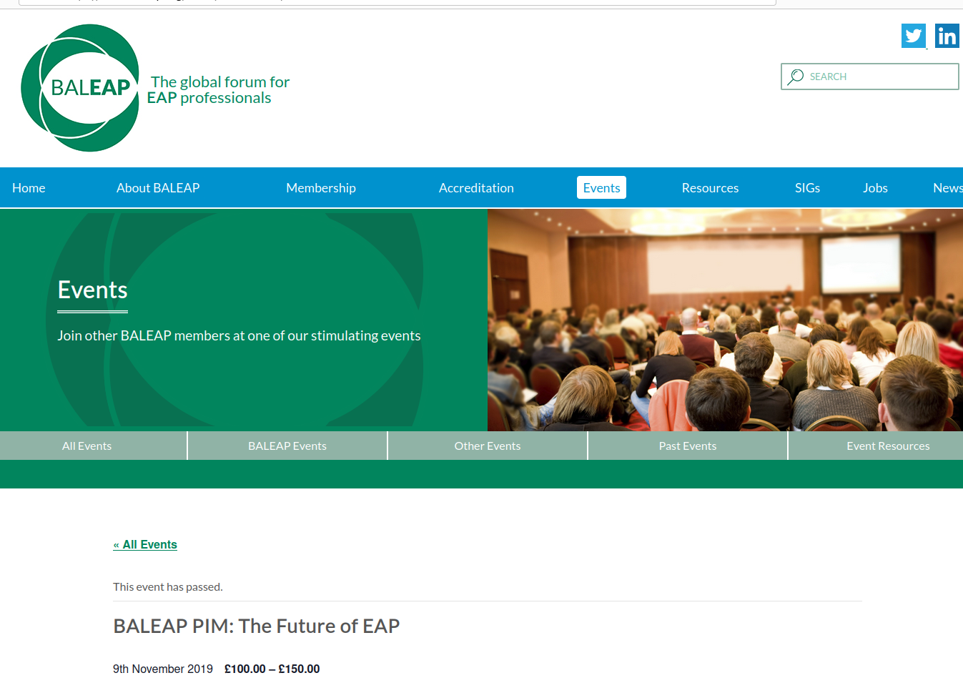
Notes:
Say who Baleap are, what the event was in 2019, what EAP is
Say we can excuse them for not predicting a pandemic was two months away, however it is baffling that not one session focussed on the climate emergency

Slide 8
reasons
Students from vulnerable parts of the world
Students are going to be impacted
Students can take positive action
Universities have sustainability action plans
Quality assurance demands it
Employability

Slide 9
Students Views
sustainable development: something which all universities and colleges should actively incorporate and promote
sustainable development has been covered in depth by their course.
Describe their feelings as ‘worried’ when thinking about climate change
92%
40%
75%
Source: Students Organising for Sustainability (2021)

Slide 10
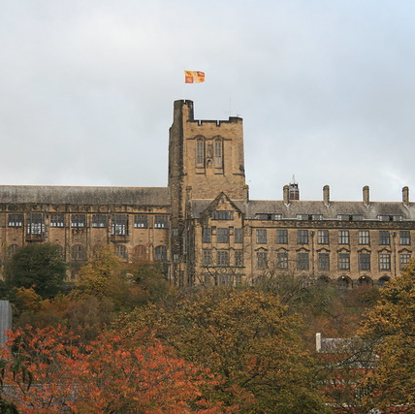
University Strategies
Sustainability will become more ingrained in all aspects of life at Bangor University and all the activities our staff and students are involved in. Particularly, we will ensure that sustainability becomes a central theme in our curriculum and research specialisms.
https://www.bangor.ac.uk/sustainablebangor
This Photo by Unknown Author is licensed under CC BY-NC-ND

Slide 11
Quality Assurance of HE: Subject Benchmarks
QAA Business and Management Benchmark Standard 2023:
It is therefore imperative that the future managers and business leaders are equipped to engage meaningfully with, and respond to, climate challenges in order to embed climate solutions in all business functions and processes. (p. 7)
QAA Business and Management Benchmark Standards for graduation (excellent)
Values: an ability to challenge assumptions, champion the values of global social responsibility while also appreciating the debates and potential contradictory views that this presents in complex business and management environments. (p. 19)

Slide 12
Quality Assurance of HE: ESD Guidance
We believe that every HEP should adopt the guidance and embed ESD across the curriculum. If we as educators are serious about preparing our students for the future, we must embrace ESD and ensure that every graduate has not only the knowledge and skills but the attributes that will enable them at least to cope and ideally thrive in the face of the multiple challenges they will face across their life course in the 21st century.
Advance HE & QAA (2021:1)

Slide 13
How can we offer ESD?

Slide 14
More of the same kind of education will only compound our problems…..the worth of education must now be measured against the standards of decency and human survival..… It is not education that will save us, but education of a certain kind”
David Orr, 1991

Slide 15
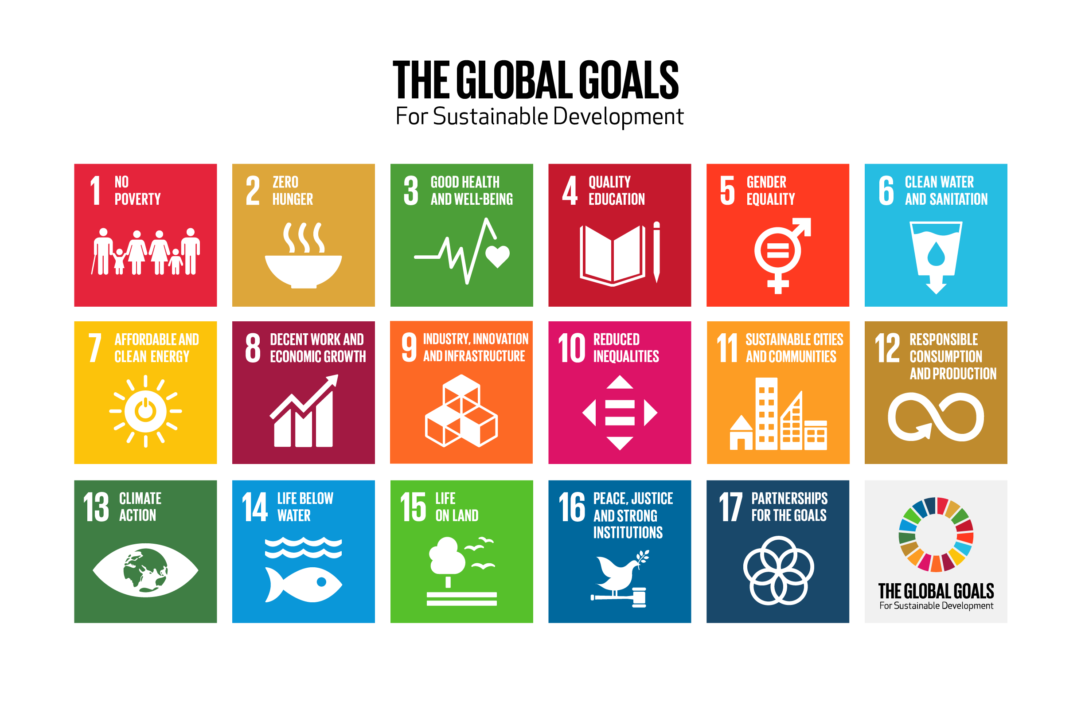
Notes:
Ask if people recognise these. Give a brief overview of the story. Say that they are ideal for lessons, syllabuses and curriculums, and they are the starting point for QAA, Advance HE and many educational institutions in embedding sustainability

Slide 16
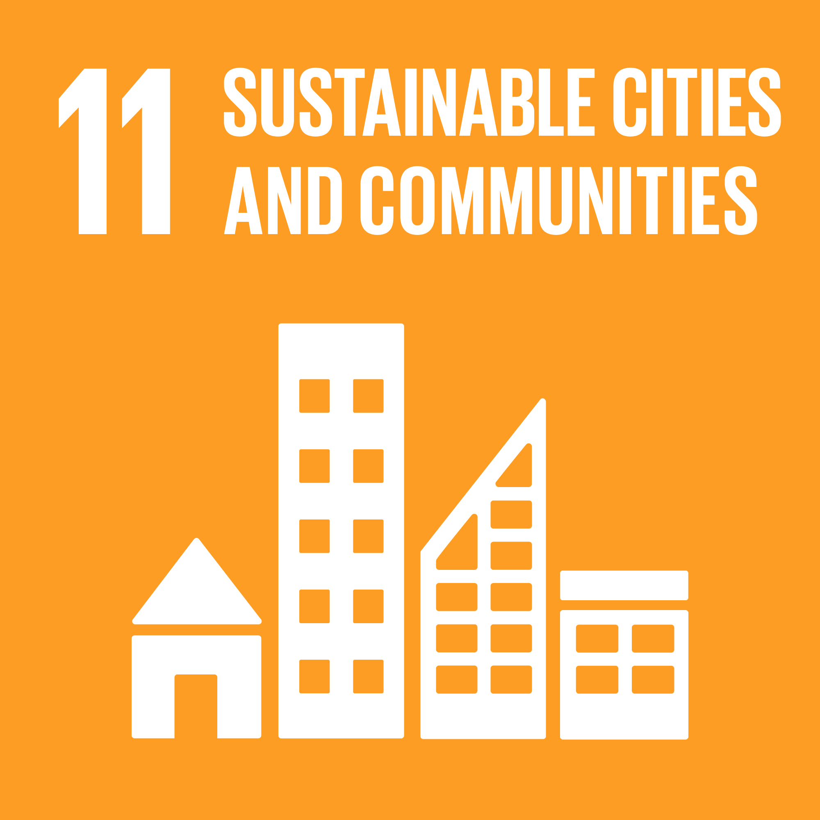
A classroom activity

Slide 17




Discuss
What can you see in these pictures?
What do the targets involve?
Why might these targets be relevant where you live?
Imagine your town has run out of money and can only afford to address 2 targets. Which ones and why?
What would you do first to address one of the targets you chose?

Slide 18
In your class …
How might you embed an activity like this?
What else could you add?
What challenges might you face in embedding the global goals into class?
How could you overcome these challenges?

Slide 19
And how you can link it to assessment
Essay Topic:
Global goal 11 - Sustainable Cities and Communities aims to make cities and human settlements inclusive, safe, resilient, and sustainable. Write an essay of 1000 words on the following:
Describe what the issues are that affect how sustainable Bangor is and identify and evaluate things that could be done to make Bangor more sustainable.

Slide 20
Q and maybe some A...

Slide 21
References
Advance HE & QAA. (2021) Education for Sustainable Development Guidance. QAA website. [Online]. Available at: https://www.membershipresources.qaa.ac.uk/teaching-learning-and-assessment/education-for-sustainable-development. Accessed 28th February 2023.
IPCC (2022) Climate Change 2022: Impacts, Adaptation and Vulnerability, Working Group II Contribution to the IPCC Sixth Assessment Report. [Online]. Available at: www.ipcc.ch/report/sixth-assessment-report-working-group-ii/
Orr, D. (2004) Earth in Mind. Washington: Island Press
QAA (2023) Subject Benchmark Statement: Business and Management. [Online]. Available at: https://www.qaa.ac.uk/docs/qaa/sbs/sbs-business-and-management-23.pdf?sfvrsn=8370a881_6
SOS International (2021) Students, sustainability and education. [Online]. Available at: https://sos.earth/wp-content/uploads/2021/02/SOS-International-Sustainability-in-Education-International-Survey-Report_FINAL.pdf
UNESCO (2021) Education for Sustainable Development: A Roadmap. [Online]. Available at: https://www.unesco.org/en/education-sustainable-development

