Slide 1
Academic self-efficacy & International students’ transitions to higher education
Engaging learners in and beyond the classroom

Slide 2
Outline
  Abbreviations
  Purpose
Part 1: Secondary Research – Academic Self-Efficacy
  Definition
  Key Skills to Focus on
  Self-Efficacy as a Core Skill
  Briefly: Improving Academic Self-Efficacy
Part 2: Primary Research Results
  Research methods
  Research results
  Analysis – Students may need help with social integratoin
Part 3: Implications, Insights and Future Research

Slide 3
abbreviations
International College Dundee (ICD)
University of Dundee (UoD)
Dundee University Student Association (DUSA)
Joint Academic Board (JAB)

Slide 4
Purpose
ICD received feedback that some graduates were struggling with their transition into the UoD, particularly in meeting deadlines and achieving academic success.
“The Survival Toolkit” project was initiated to improve foundation and presessional student transition to university and enhance their resilience and succeed academically.

Slide 5
Part 1 secondary research: Self-Efficacy

Slide 6
Definition – academic Self-Efficacy
“…academic self-efficacy refers to the individuals' convictions that they can successfully perform given academic tasks at designated levels.” (Schunk 1991, cited p. 2 in Cheng et al. 2023).
“Academic self-efficacy (ASE) refers to a student’s global belief in his/her ability to master the various academic challenges at university and is an essential antecedent of wellbeing and performance.” (van Zyl et al, 2022).
Self-belief in academic success
Self-confidence in achieving academic success, even after setbacks
Key differentiation: View assignments as challenges vs threats

Slide 7
TRANSITION Skills to focus on
1. Self-Efficacy
5. Social Skills
2. Critical Self-Reflection
6. Dealing with Stress
3. Independent Learning
7. Critical thinking
4. Self-Management of Expectations
8. Academic and information literacy
Cheng et al., 2023

Slide 8
ACADEMIC SELF-EFFICACY AS A CORE SKILL
Self-management of expectations
Realistic goal setting
Academic Success
Academic Self-Efficacy
Critical Self-Reflection
Independent Learning
Social Self-Efficacy
Career Self-Efficacy
Implications for ICD:
Finding the balance between supporting self-efficacy and realistic self-management of expectations

Slide 9
Issues with Critical Self-Reflection
Not engaged with in other cultures (Gardner et al, 2006)
Not encouraged or supported in workplaces (Gardner et al, 2006)
Can be harmful to self-efficacy if not managed correctly (Yip, 2006)
Students need to invest in contemplation and exploration of different views (Stronach et al, 2007)
  Technical skills more important
Students need external support (Harri-Augstein and Thomas, 1991)
Self-reflection on its own does not promote critical reflective learning (Brockbank and McGill, 2007)
Cited in Cheng et al., 2023

Slide 10
Briefly: Improving Academic self-efficacy
Enactive Mastery Experiences
  Basically doing tasks well and getting good grades
  But not easy success, this undermines resilience and confidence (Bandura 1977)
Peer observation
  Need to observe success (Schunk 1987)
Persuasion
  Combined with evaluative feedback from someone seen as knowledgeable (Bong and Skaalvik, 2003)
  Can be undermined by poor grades
Phycological and emotional state
  Before, during and after tasks
  Creating safe spaces to express ideas through role-play (McKinely, 2023)
  Stress is energising vs perceived weakness (van Dinther et al 2010)
NB: These are also areas that need to be continued at university, particularly 2.

Slide 11
Implications and ideas for implementation
Create engaging material for a handbook
Bring it to life in classes (due to student issues with critical self-reflection)
Create a bank of topic specific and general activities
Incorporate these into lessons

Slide 12
Part 2 primary research
No research found in this area from my initial literature review.
Quantitative –
      Likert Scale: Specific academic self-efficacy questions (6 participants)
Qualitative –
      Focus groups: prompts on academic self-efficacy and student experience (6 participants)
  Following these allowed for the capturing of numerical trends and individual narratives

Slide 13
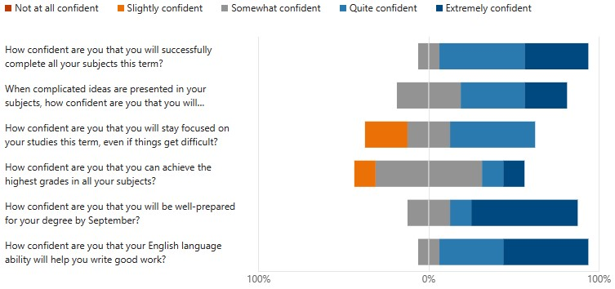
Likert Scale:
Specific academic self-efficacy questions
Week 1 April Response
1.
2.
3.
4.
5.
6.
Adapted from Educational self-efficacy scale (n.d.)

Slide 14
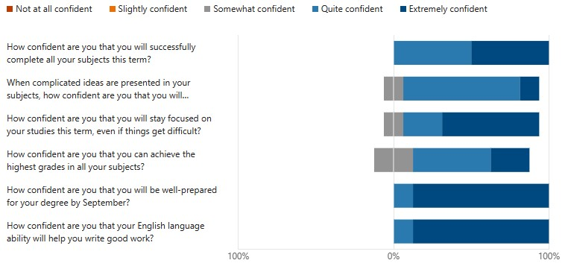
Likert Scale:
Specific academic self-efficacy questions
Week 10 June Response
1.
2.
3.
4.
5.
6.
Adapted from Educational self-efficacy scale (n.d.)

Slide 15
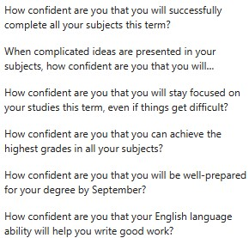
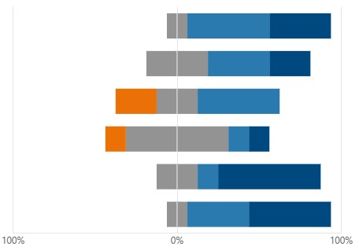
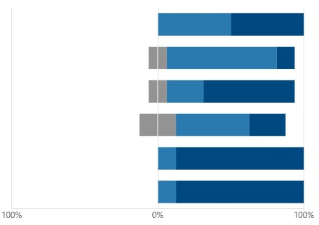
Likert Scale:
Specific academic self-efficacy questions
1.
2.
3.
4.
5.
6.
Adapted from Educational self-efficacy scale (n.d.)

Slide 16
Qualitive results – Focus Group (6)
Highlights:
A few students staying at home a lot; most making friends from own countries/cultures.
Expected more social activities and events.
Wanted more opportunities to socialise with peers across courses.
E.g. a dedicated area for students to meet, socialise, have lunch etc.
Some told could not join student societies until September by DUSA.
Cheng et al. (2023) local/home friends are important for:
  successful transitions of international students to university life.
  academic self-efficacy.

Slide 17
PART 3 - Insights, Implications and Future Research

Slide 18
Implications and insights
Continue with efforts to integrate April cohort ICD students with their UoD peers.
  Linking students more explicitly with UoD and DUSA events and social areas.
  Current expansion of student experience team.
  ICD DUSA President role (JAB, 2023).
  Arranging days societies could visit and advertise their clubs throughout the year.
Post-Pandemic: Potential loss of student community and cohort identity due to COVID-19 (JAB, 2023).
  How could social cross-cultural integration be encouraged for ICD and UoD (JAB, 2023)?

Slide 19
Future research
Follow-up on April cohort at the end of summer to track their social self-efficacy/integration.
Look at social self-efficacy across cohorts e.g. September starters
Already surveys on academic progression and self-efficacy, but not much focus on social self-efficacy.
Sharing good practice and discussing with partner colleges, particularly with later intakes like April.
this study was focused on April starters who are most isolated.

Slide 20
Current key INSIGHT
What we will take to the next JAB is that student transitions to higher education is more than just the academic focus, and work with the university on ensuring students are socially supported on their academic journey.

Slide 21
Summary
Secondary research
Importance of self-efficacy; issues with critical self-reflection
How to improve academic self-efficacy and resilience
Implications for ICD
Primary research
Qualitative and quantitative
Strong academic self-efficacy
Possible issues with social integration
Future research:
Following-up with April students
Cross-cohort research on social integration and self-efficacy

Slide 22
References
Babaee, N. (2023). ‘Creating a Transcultural Academic Writing Class in a Canadian College.’ Towards transcultural pedagogy: dynamics in global EAP, 4 March 2023, St. Andrews
Blanchett, C., and Iwasienko-Clarke, G. (2023) ‘Trials and tribulations of a TNE – lessons learnt.’ Towards transcultural pedagogy: dynamics in global EAP, 4 March 2023, St. Andrews
Bandura, A and Cervone, D (1983) Self-evaluative and self-efficacy mechanisms governing the motivational effects of goal systems, Journal of Personality and Social Psychology, 45, pp 1017-1028
Bong, M and Skaalvik, E M (2003) Academic Self-Concept and Self-Efficacy: How Different Are They Really? Educational Psychology Review, 15(1), pp 1-40
Bourdieu, P., & Passeron, J. C. (1994 [1965]). Introduction: Language and the relationship to language in the teaching situation. In P. Bourdieu, J. C. Passeron & M. de Sanit Martin (Eds) Academic Discourse: Linguistic Misunderstanding and Professorial Power (pp. 1-34). Cambridge: Polity Press.
Cheng, M., Barnes, G.P., Edwards, C., Valyrakis M., (2023) ‘Transition Skills and Strategies: Critical Self-reflection.’ Enhancement Themes. Available at: https://www.enhancementthemes.ac.uk/docs/ethemes/student-transitions/critical-self-reflection.pdf (Accessed: March 2023)
Cheng, M., Barnes, G.P., Edwards, C., Valyrakis M., (2023) ‘Transition Skills and Strategies: Key Transition Skills.’ Enhancement Themes. Available at: https://www.enhancementthemes.ac.uk/docs/ethemes/student-transitions/key-transition-skills.pdf (Accessed: March 2023)
Cheng, M., Barnes, G.P., Edwards, C., Valyrakis M., (2023) ‘Transition Skills and Strategies: Key Transition Skills at the Different Transition Points.’ Enhancement Themes. Available at: https://www.enhancementthemes.ac.uk/docs/ethemes/student-transitions/skills-at-different-transition-points.pdf (accessed March 2023)

Slide 23
References
Cheng, M., Barnes, G.P., Edwards, C., Valyrakis M., (2023) ‘Transition Skills and Strategies: Self-efficacy.’ Enhancement Themes. Available at: https://www.enhancementthemes.ac.uk/docs/ethemes/student-transitions/self-efficacy.pdf (Accessed: March 2023)
Cheng, M., Barnes, G.P., Edwards, C., Valyrakis M., (2023) ‘Transition Skills and Strategies: Transition Models and How Students Experience Change.’ Enhancement Themes. Available at: https://www.enhancementthemes.ac.uk/docs/ethemes/student-transitions/transition-models-and-how-students-experience-change.pdf (Accessed: March 2023)
Educational self-efficacy scale (n.d.) Available at:
https://www.imperial.ac.uk/education-research/evaluation/what-can-i-evaluate/self-efficacy/tools-for-assessing-self-efficacy/educational-self-efficacy-scale/ (Accessed: 13 June 2023).
‘Joint Academic Board Meeting’ (2023), University of Dundee. Unpublished.
McKinely, J. (2023). ‘Transcultural competence for ‘comfortable’ EAP: transforming the conflicts of the third space.’ Towards transcultural pedagogy: dynamics in global EAP, 4 March 2023, St. Andrews
Schunk, D H (1991) Self-efficacy and academic motivation, Educational Psychologist, 26, pp 207-231
van Dinther, M, Dochy, F and Segers, M (2010) Factors affecting students' self-efficacy in higher education, Educational Research Review, 6, pp 95-108
van Zyl, L.E., Klibert, J., Shankland, R., See-To, E.W.K., & Rothmann, S. (2022). The General Academic Self-Efficacy Scale: Psychometric Properties, Longitudinal Invariance, and Criterion Validity. Journal of Psychoeducational Assessment, 40(6), 777-789. Available at: https://doi.org/10.1177/07342829221097174

Slide 24
Special Thanks
Dr. Corinne Wales: College Director, International College, University of Dundee
Dr. Steven Herron: Director of Learning, Teaching and Academic Affairs

Slide 25

Questions?

