Slide 1
Effective classroom-based assessment and feedback
Oxford International University Partnerships
Learning, Teaching and Student Experience conference 2023
Thom Kiddle
Director, NILE

Slide 2

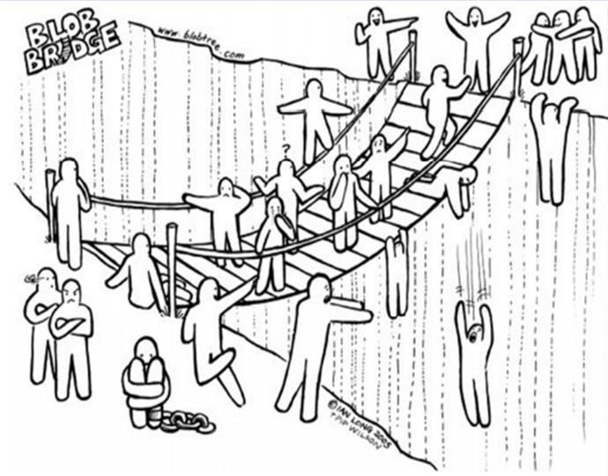
How do you feel about your assessment practices?
Licensed for educational use from www.blobtree.com

Slide 3



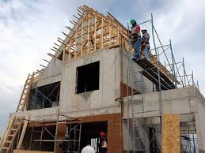
Assessment planning analogies…
Planning an assessment activity is like…

Slide 4

Analogy suggested by Prof. Lynda Taylor
Planning an assessment activity is like…

Slide 5
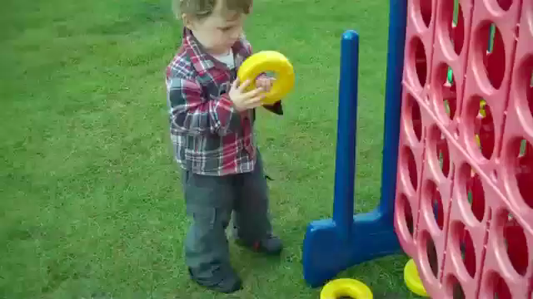
Teaching, Learning and Assessment – the task

Slide 6
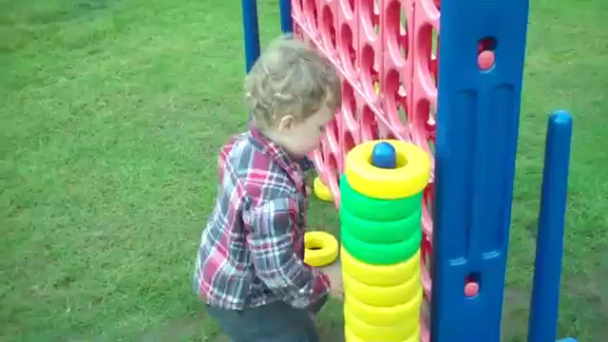
Teaching, Learning and Assessment – the results!

Slide 7
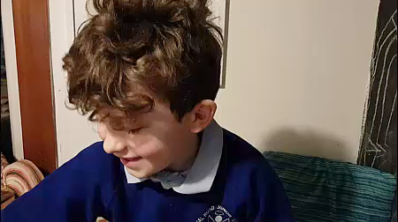
Pace of progress

Slide 8


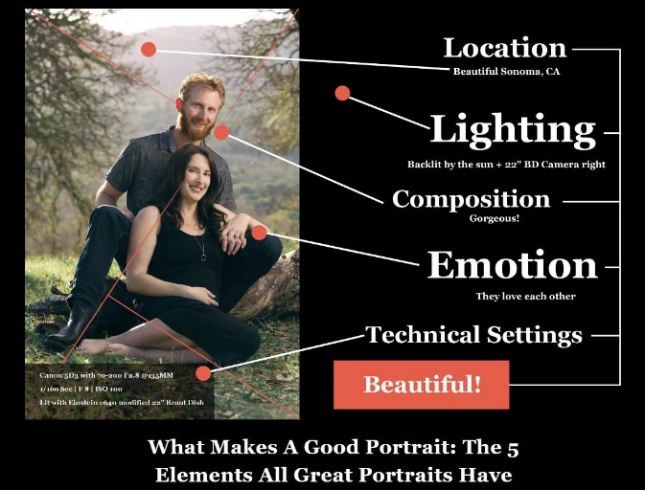
Measuring performance and knowledge
How do we, and our students, know how good their performance or knowledge is?
Comparison with own previous performance / knowledge
Comparison with others in same class / level
Comparison against external criteria

Slide 9

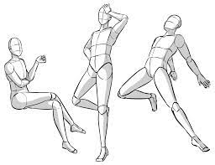
What to measure
How can we elicit a representative and meaningful sample of our learners’ performance or knowledge?

Slide 10
A representative sample
What are the features of a representative and assessable sample of learners’ performance or knowledge?
enough evidence of all the aspects we need to judge, and probably more than one instance of each;
focused and restricted enough to allow comparison (with own previous performance, or others, or criteria);
directly and transparently related to real-world use of the knowledge or skill (NB. Academic world is still ‘real-world!)
a familiar enough question or task type not to throw learners
questions or tasks whose answers depend on the skills / knowledge we want to assess, not other skills / knowledge

Slide 11
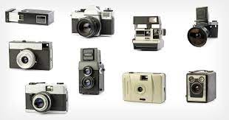
The options on offer
What task types or digital tools might help elicit samples of ability / knowledge in a particular classroom assessment context?

Slide 12
Unpicking the options
We want to assess our learners’ ability to give a short oral presentation on a topic of contemporary relevance in their field.
Oral presentation with accompanying visuals at front of class;
Poster presentations with several learners presenting to small audiences in different spaces / parts of classroom;
Screencast (e.g. with Screencast-o-matic) recorded and submitted to teacher;
“Padlet” activity where learners respond using webcam / mobiles to teacher’s prompt;
Self-recorded video using webcam / mobile phone submitted to teacher;
Group task where 3 students each present a different part of the same topic and coordinate the presentation together.

Slide 13
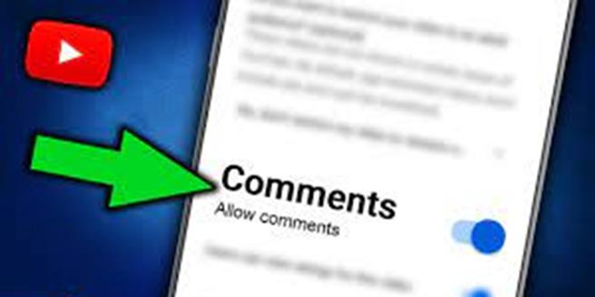
Feeding back and feeding forward
What options do we have for giving formative feedback on our classroom assessments?

Slide 14
Exploring feedback options
What options do we have for giving formative feedback on our classroom assessments?
Sentence auctions: a mix of good and poor language / content from whole class’s assessments – learners have to discuss and bid for the ones they think are good;
Screencasting individual commentaries on learners’ work and sending video files;
Class-designed checklists for self- or peer-assessment of tasks;
Gallery walk with examples of best practice from assessments;
Comparison with ‘model answers’ for self-assessment or teacher-led discussion;
Correction codes discussed, practiced and agreed with class;
WWW and EBI (What Went Well and Even Better If…) feedback;

Slide 15
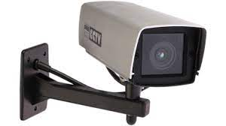
Embracing the Dark Side
How do we use external or institutional tests and exams as part of classroom learning?

Slide 16
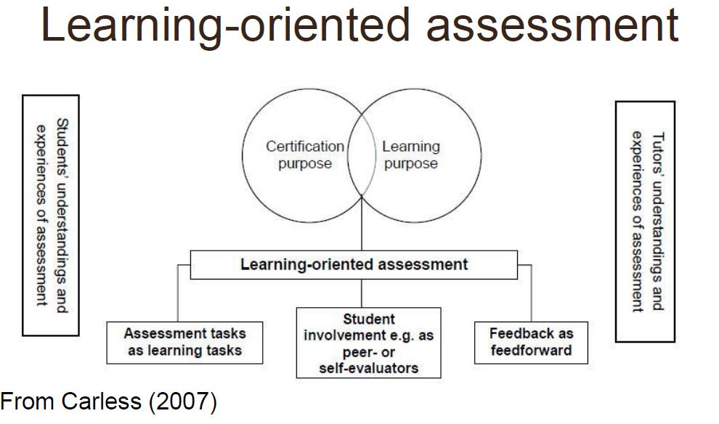
Learning-oriented assessment
How do we use external or institutional tests and exams as part of classroom learning?

Slide 17
Critically evaluating assessment tasks
Assessment buddies for peer review
Take tests without answer key
Trial with students – they’ll always surprise you!

Slide 18
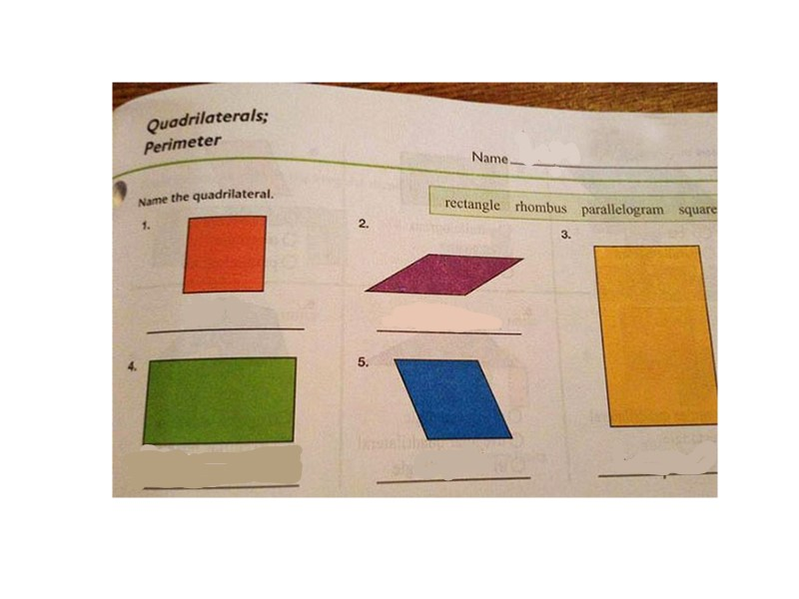
Critically evaluating assessment tasks

Slide 19
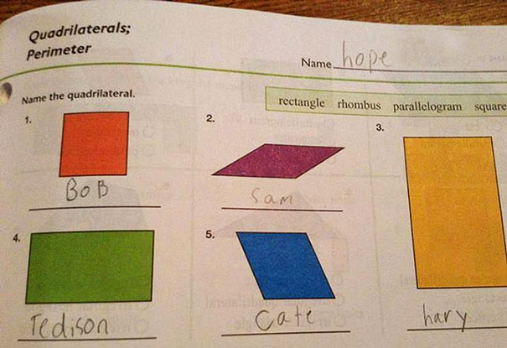

Slide 20
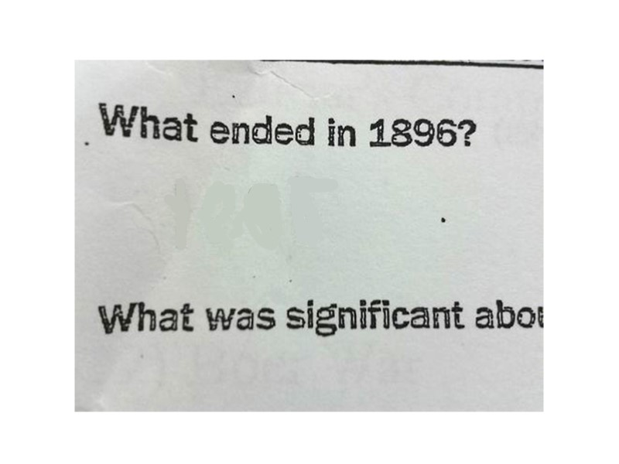

Slide 21
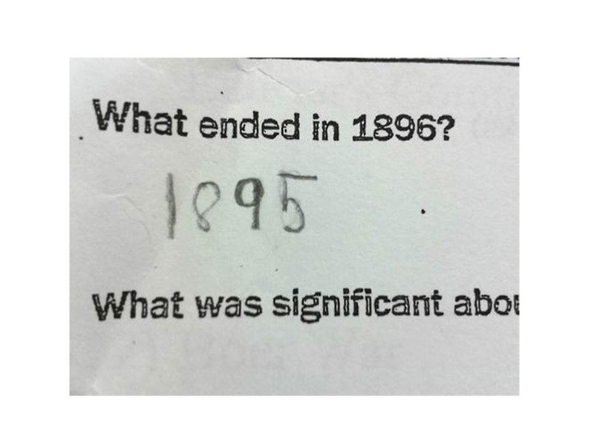

Slide 22
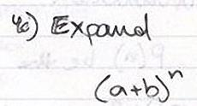

Slide 23
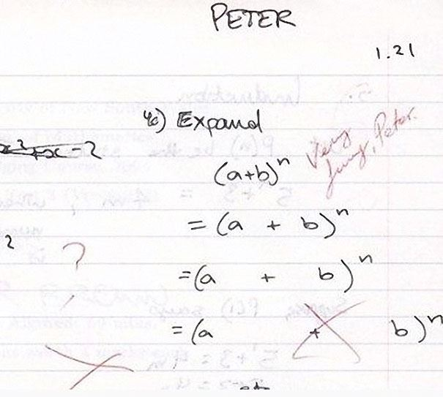

Slide 24
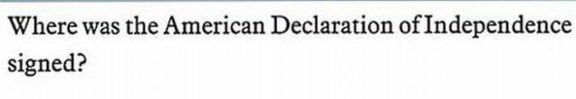

Slide 25
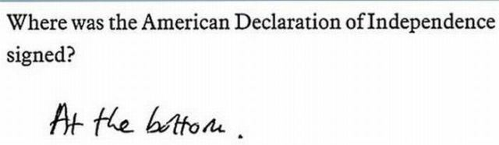

Slide 26
Your role as photographer

Slide 27
Heading in the right direction?
Licensed for educational use from www.blobtree.com

Slide 28
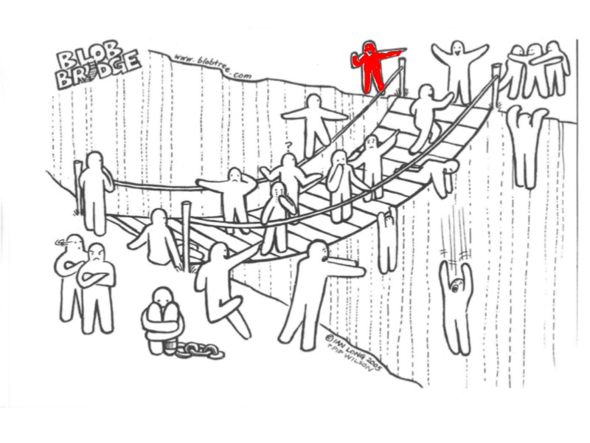
Heading in the right direction?
Licensed for educational use from www.blobtree.com

Slide 29
Heading in the right direction?
Thank you!
thom@nile-elt.com

