Slide 1


The Learner Environment
Yvonne Leonard
Peter Hughes
Learning, Teaching and Student Experience Conference, 2023
28 June 2023

Slide 2

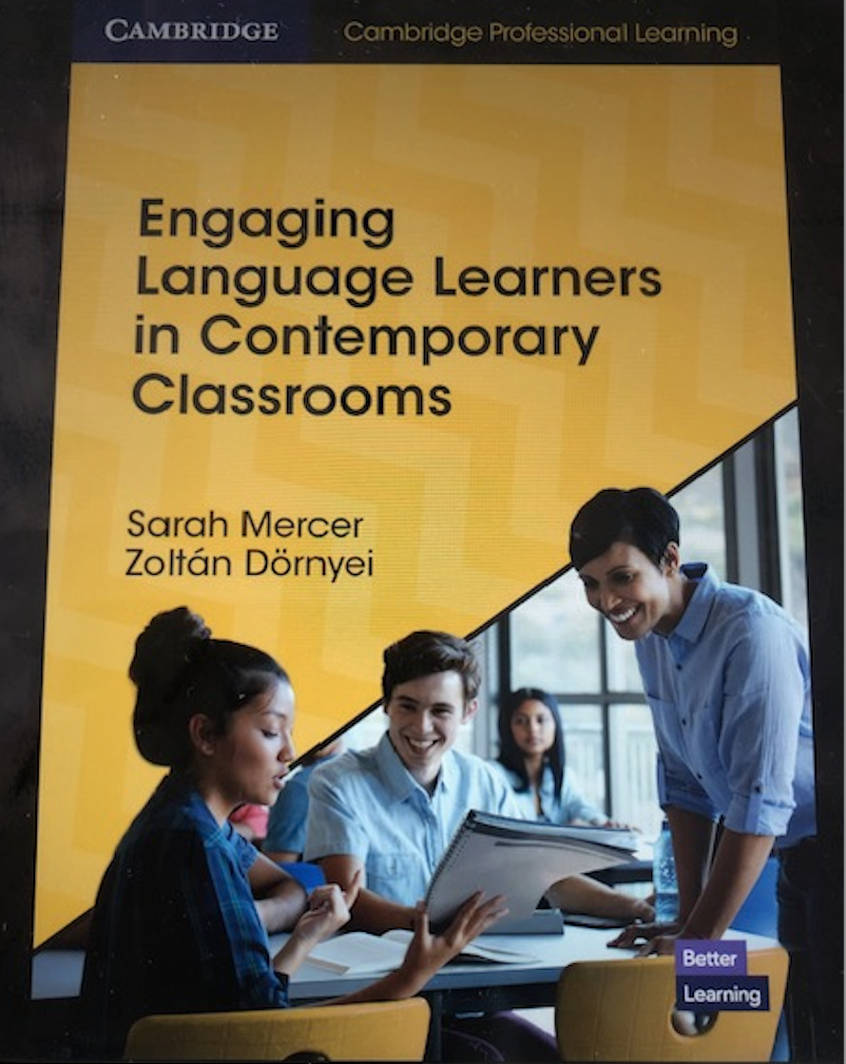
Introduction
“The ‘twitch-speed’ pace and multi-layered delivery of modern media can make a lecture feel incredibly slow and boring. Globalisation and open door access have filled our classrooms with learners reflecting such a dizzying array of backgrounds and academic preparedness that teachers are often hard-pressed to find a collective starting point or the commonalities that create a sense of community…”
(Barkley, 2010, as cited in Mercer & Dornyei, 2020, p.6)
Image source: pexels.com

Slide 3
Introduction
With the aim of trying to increase the level of engagement in our classrooms, our presentation will cover practical ideas and strategies for:
Building rapport
Factoring in movement
Empowering learners
Increasing transparency through signposting
Embracing multiculturalism

Slide 4
Building rapport
Multicultural classrooms – myriad of background experiences.
Issues:
    Shyness
    Mistrust
    Fear of embarrassment
    Lack of familiarity with other cultures
Limited time with extensive content to cover - assessment pressure.
Building rapport lowers the affective filter and encourages risk taking.

Slide 5
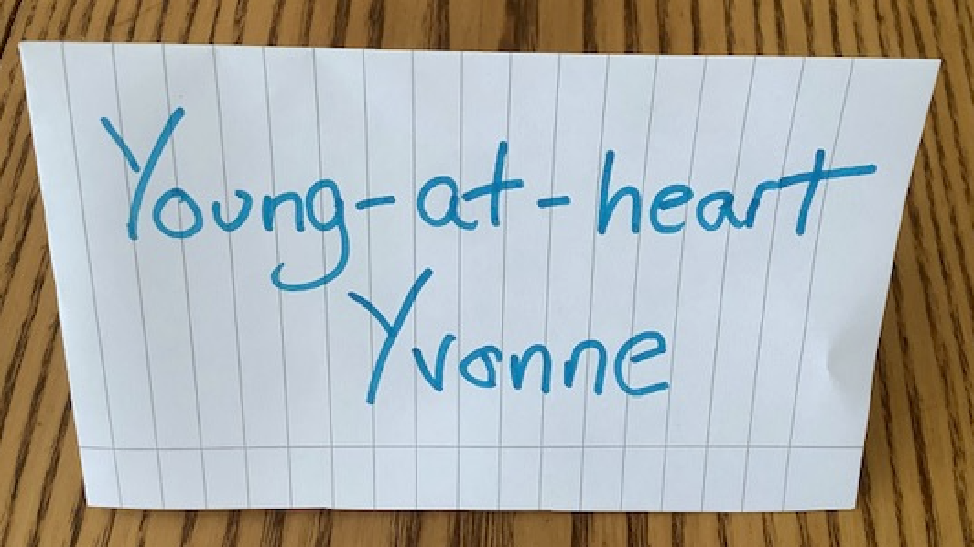
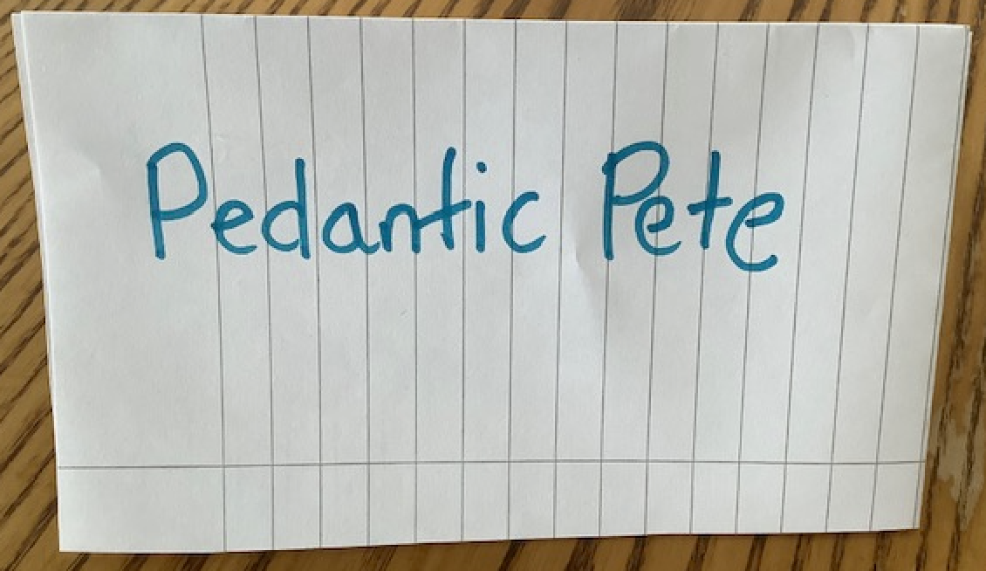
Building rapport
Learn student names, including pronunciation!
Shows respect for them as individuals.
Generates a sense of belonging (Mercer & Dornyei, 2020, p.56).
(@teachingEAP2498, 2020)

Slide 6
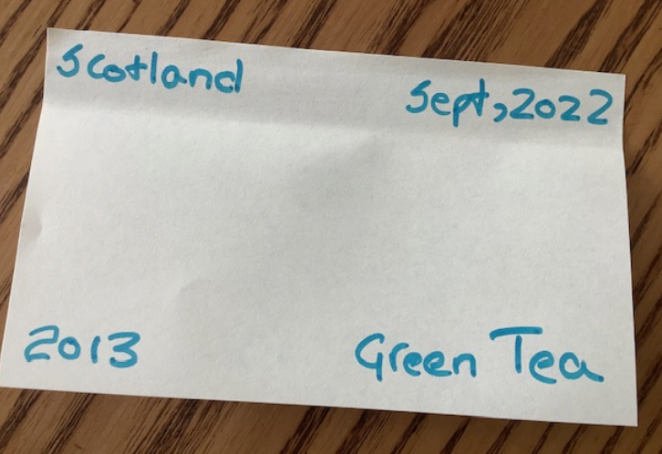
Building rapport
Use ‘ice-breakers’.
Students relax, start smiling and share a little of their personal story.
Allow students to learn about their tutor.
4 things about you, 6 questions
Two truths and a lie
I lived in Australia for 22 years.
I’ve seen a real dinosaur egg.
I’m an expert piano player.

Slide 7
Building rapport
Don’t stop with an ice-breaker. Use warmers regularly.
Generate feelings of confidence and security.
Pair and re-pair students to help build empathy and develop intercultural communication skills and understanding (Mercer & Dornyei, 2020, p.55).
(@teachingEAP2498, 2020)

Slide 8
Building rapport
Draw 5 circles. Write or draw your answers in the circles. One word or picture only.
If you could eat your favourite meal right now, what would it be?
If you think about someone who inspires you, who would it be?
If I were to give you a ticket to somewhere you’ve been to in the world, where would you choose to go back to?
If I asked you to summarize last year in 1 word, what word would you choose.
Close your eyes. Imagine yourself 10 years from now. Where are you living? What type of work are you doing? Are you living with others or by yourself? Do you have any animals around you? You can write more than one word or draw more than 1 picture for this one.
(@teachingEAP2498, 2020)

Slide 9
Building rapport
Sources for EAP warmers.
Classroom dynamics by Jill Hadfield.
Warmers for EAP: standalone activities for busy teachers by Richard Haywood.
Energising EAP by Meredith Macaulay.
TEFL EAP Warmers by @teachingEAP2498, 2020) https://www.youtube.com/watch?v=b6kRIHsoEjA

Slide 10
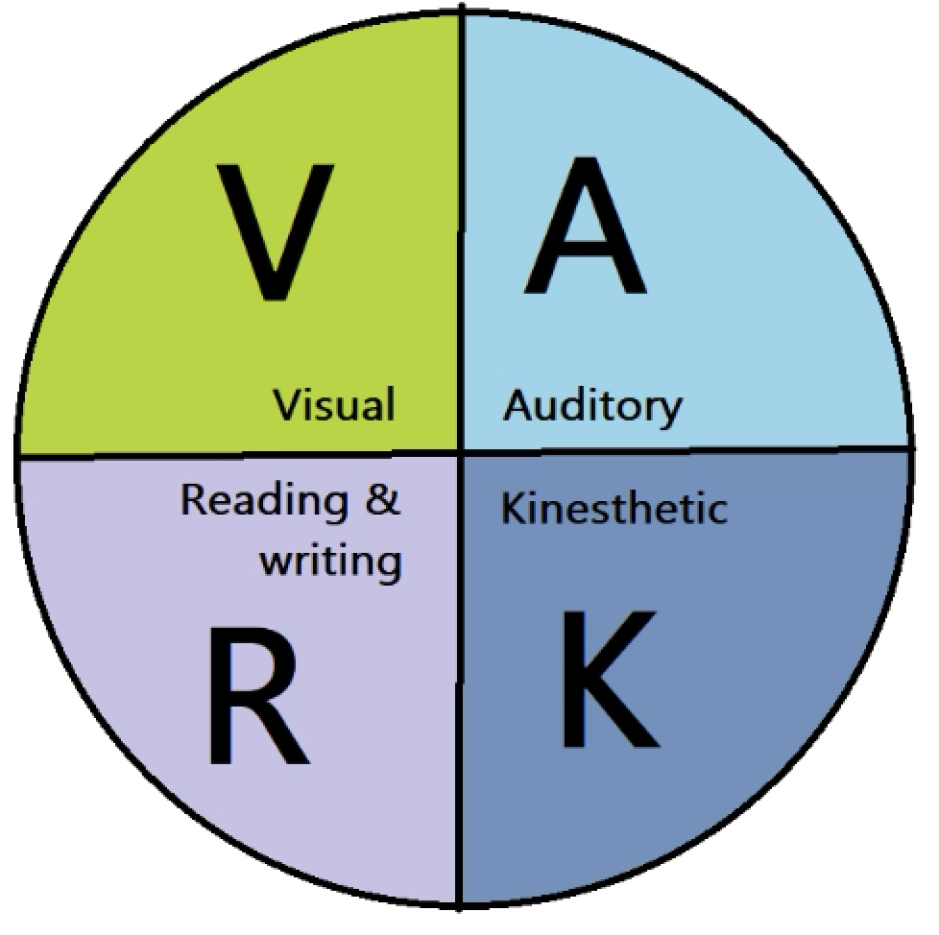
Movement
VARK model – most closely associated with work based on Gardner (1983).
Not held up in experimental evidence (Massa and Mayer, 2006).
No neurological basis (Blanchette, Sarrasin et. al. 2019).
Persists in education.

Slide 11

Movement
Different modalities suit different tasks, not different brains (Warne, 2020).
Kinesthetic activities still have real applications (Chisholm and Spencer (2017).
Important to understand why it is effective when implementing it.
Boredom reduction.
Image source: pexels.com

Slide 12
Movement
Chisholm & Spencer’s (2017) general tips:
Experiment first – continue if positive.
Some concepts lend themselves to kinesthetic activities.
Must serve a clear pedagogical purpose.
Consider how to accommodate possible learner limitations.

Slide 13

Movement - activities
Easy to prepare and apply to pre-existing lesson plans.
Feedback on whiteboard
Post-it notes around room
Discovery task/jigsaw
Image source: Pexels.com

Slide 14

Learner empowerment
Image source: Pexels.com
Desired outcome versus barriers to success.
Issues: passive learners, differences between UK style education and previous experiences, language barrier, stress, loneliness…
How can we facilitate a growth mindset?

Slide 15
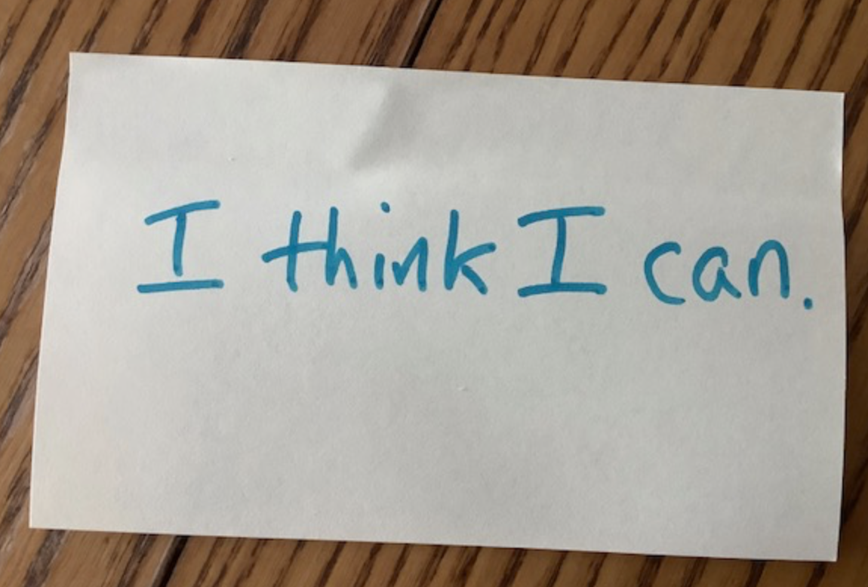
Learner empowerment
Instil self-belief.
Encourage self-regulation of emotional responses. What went right? What went wrong? What did you learn? What will you do differently?
Mentimeter. How do you feel about the assessment you have just completed?
Minute paper. Enables teacher to keep apace with learners’ state of mind and sense of progress.

Slide 16

Learner empowerment
Encourage a sense of agency and an active learning culture through goal-setting.
Whitmore’s GROW model – teacher as coach (Mercer & Dornyei, 2020, p.41)
G What are your goals?
R What is the reality?
O What are your options?
W What will you do?
Build realistic awareness of strengths, weaknesses and how to improve.
Image source: Pexels.com

Slide 17
Learner empowerment
Goal setting – developing a positive attitude to the course.
Group students. Provide a sheet of A3 paper.
Students brainstorm the ways in which aims can be achieved by
successful completion of the course (e.g. continue on to university)
improving their level of English in general (e.g. better job prospects)
developing specific skills (e.g. better able to read and understand academic articles)
Display A3 posters around walls to share ideas.
Students then ask themselves and write down the answers to the following questions:
  What can you do now?
  What should you be able to do to when you’ve finished the course?
  What skills do I need to improve to achieve my aims?
May, 2000. p.19

Slide 18
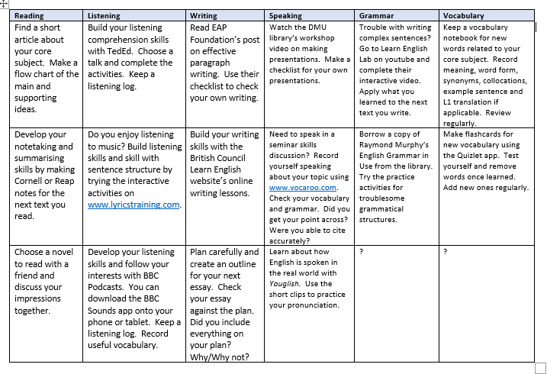
Learner empowerment – choice boards

Slide 19
Signposting
Transparency in learning and teaching (TILT)
Only small changes needed.
Equitable – learners not from academic cultural background.
Long-lasting benefits.
(Winkelmes, Boye and Tapp, 2019)

Slide 20
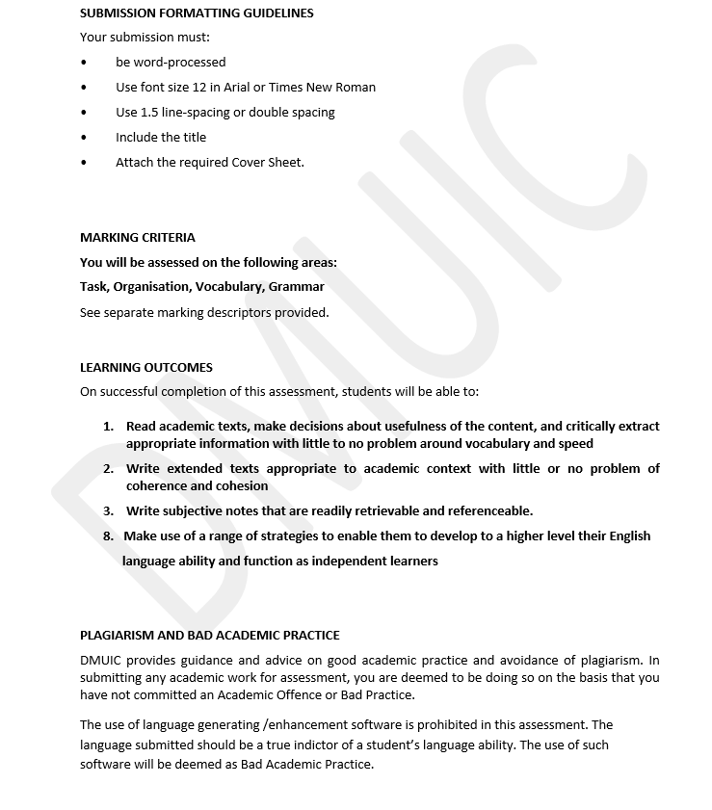
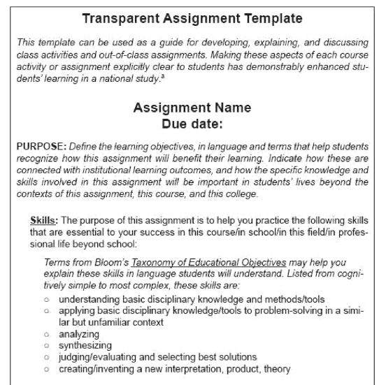
Signposting – clear learning objectives
DMUIC already does this (better than as suggested in the book).
Link to student aims.
(Winkelmes, Boye and Tapp, 2019, p.8)

Slide 21
Signposting – explain everything
Never say ‘because that’s the way it is’.
In a Harvard style reference list, why are book titles written in italics, but journal article titles written in inverted commas?
Why does academic style usually preclude the use of first and second person pronouns?
Tell students the reasons for these conventions.
Link to their future.

Slide 22
Embracing multiculturalism
International students, joining a highly multicultural environment, perhaps transiently.
Global citizens; range of linguistic resources at their disposal; access to global culture through the internet (Baker, p. 19).
Develop intercultural communication skills and understanding.

Slide 23
Embracing multiculturalism
Build awareness of other cultures.
Discuss norms of conduct in the international classroom.
Encourage a perception of English as a lingua franca. Relate to future roles in the global workplace.
Provide process language for discussions; language for repair, clarification, dissent, qualified agreement. Reduce sensitivity to accent.
Encourage students to evaluate how their perceptions are evolving as a result of increased multicultural contact.
Consider a role for translanguaging in helping students to understand and potentially show their understanding of content.

Slide 24
Summary
Build rapport with activities - keep it going throughout the term.
Encourage a ‘can-do’ mentality and help students to feel in control of their learning paths.
Use movement (but not framed in terms of multiple intelligences).
Never say ‘because that’s the way it is’.
Facilitate intercultural understanding and communication skills.

Slide 25
References
Blanchette Sarrasin, J., Riopel, M., and Masson, S (2019) ‘Neuromyths and their origin among teachers in Quebec’ Mind, Brain, and Education, 13(2), 100-109.
Chisholm, A., and Spencer, B. (2017) ‘Let’s get moving!: Eight ways to teach information literacy using kinesthetic activities’ Pennsylvania Libraries: Research & Practice, 5(1), 26-34.
Baker, W. (2022). Intercultural and transcultural awareness in language teaching. Cambridge: Cambridge University Press.
Gardner, H. (1983) Frames of Mind: The Theory of Multiple Intelligences, New York: Basic Books.
Massa, L.J. and Mayer, R.E. (2006) ‘Testing the ATI hypothesis: Should multimedia instruction accommodate verbalizer-visualizer cognitive style?’ Learning and Individual Differences, 16(4), pp.321-335.
May, P. (2000). Exam Classes. Oxford: Oxford University Press
Mercer, S. and Dornyei, Z. (2020) Engaging learners in contemporary classrooms. Cambridge: Cambridge University Press
Warne, R. T. (2020) In the know: Debunking 35 myths about human intelligence. Cambridge: Cambridge University Press.

Slide 26
Questions?

Slide 27
Glossary
Affective filter: a term coined by Krashen to describe the negative feelings students may have which affect their ability to learn.
Agency: understanding of what is required to achieve a goal and a sense of control over and ownership of the process.
Growth mindset: a belief that you have the ability to develop and improve your skill set through application and constructive response to feedback.
Kinaesthetic: learning through physical activity.
Modalities: different ways in which people receive or store information e.g. visual, auditory, kinaesthetic.
Multiple intelligences: a theory closely connected with Gardner and related to the way students learn and acquire information. Everyone has a range of ‘intelligences’ e.g. musical, linguistic, visual-spatial and the way they learn may be enhanced according to the mode in which information is presented.
Passive learning: learning where students, for example, receive information from a teacher but produce or are not expected to produce any output related to the content.
Translanguaging: educational practices that allow students to use the full range of linguistic resources at their disposal to learn or express understanding of content.

